Slide 1
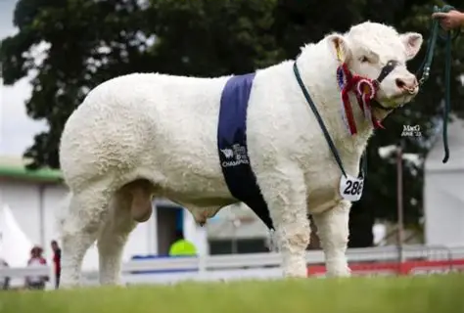
FARMER LED,
FARMER DRIVEN
EnviroBeef Day
Barnbackle Farm, Dumfries
14th May 2026

Slide 2
EnviroBeef Day
Environmental efficiency is not achieved through separate management practices, but through the same breeding and management decisions that underpin profitable, resilient beef production. Throughout the day, attendees explored how selecting cows that are fertile, healthy, efficient and long-lasting delivers benefits for both farm business performance and environmental outcomes.
The event aimed to:
Demonstrate the link between productive cows and environmental efficiency.
Show how key performance traits contribute to lower emissions and improved resource use.
Share practical examples from a commercial farming system.
Encourage discussion around breeding and management decisions that support both profitability and sustainability.
What is a Green Cow?
A “green cow” is not a different type of animal or a cow with a lower environmental impact simply because of its appearance or breed. It refers to a cow that is environmentally efficient, one that produces more output while using fewer resources and creating fewer emissions per unit of product.
Fertile | Calves regularly and at the right age, reducing the number of unproductive days.
Healthy | Requires fewer veterinary treatments and stays productive for longer.
Long Lived | Remains in the herd for more years, spreading the environmental cost of rearing her over more calves.
Efficient | Converts feed and forage into growth and production effectively.
Productive | Produces heavier, healthier calves or more output from the same resources.
Resilient | Performs consistently under varying conditions.
DUMFRIES

Slide 3
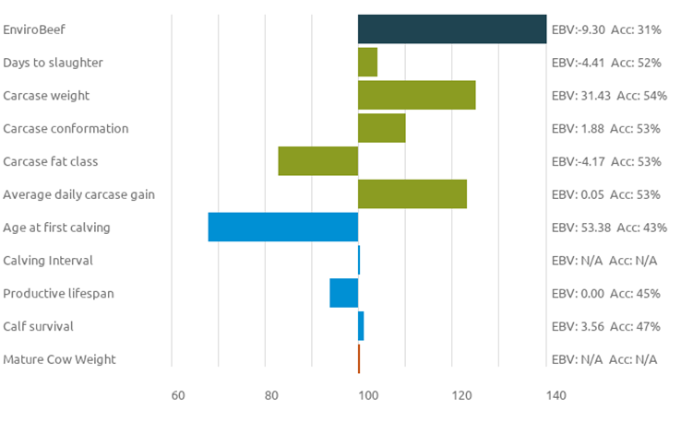
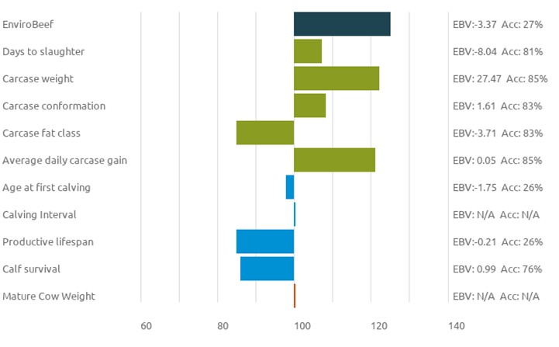
EnviroBeef Day
Animal Reports
Young Stock Report
Stand Out Animal:
(Ricknck Apache), a Jan 2025
born male Charolais
Productivity Credentials:
High carcase weight +31 kg
Positive calf survival +3.56%
Environmental Credentials:
EnviroBeef -9.3%
Bull Report
Stand Out Animal:
Ricknick Spartacus, pedigree
Charolais
Productivity Characteristics:
Growth
-8.04 days to slaughter
+27.47 kg Carcase weight
+0.05 ADG
Environmental Characteristics:
-3.37%
How can you access this data? Access is available alongside the national beef evaluations, allowing producers to use the information without making any changes to their current systems. By using this data, farmers can improve productivity and environmental sustainability while continuing with their existing management practice
National Beef Evaluation
DUMFRIES

Slide 4
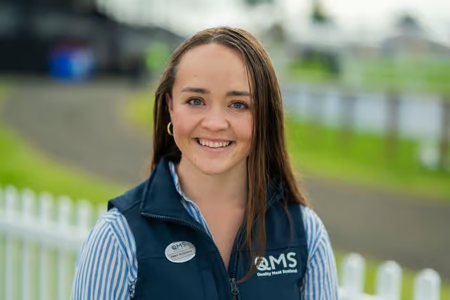
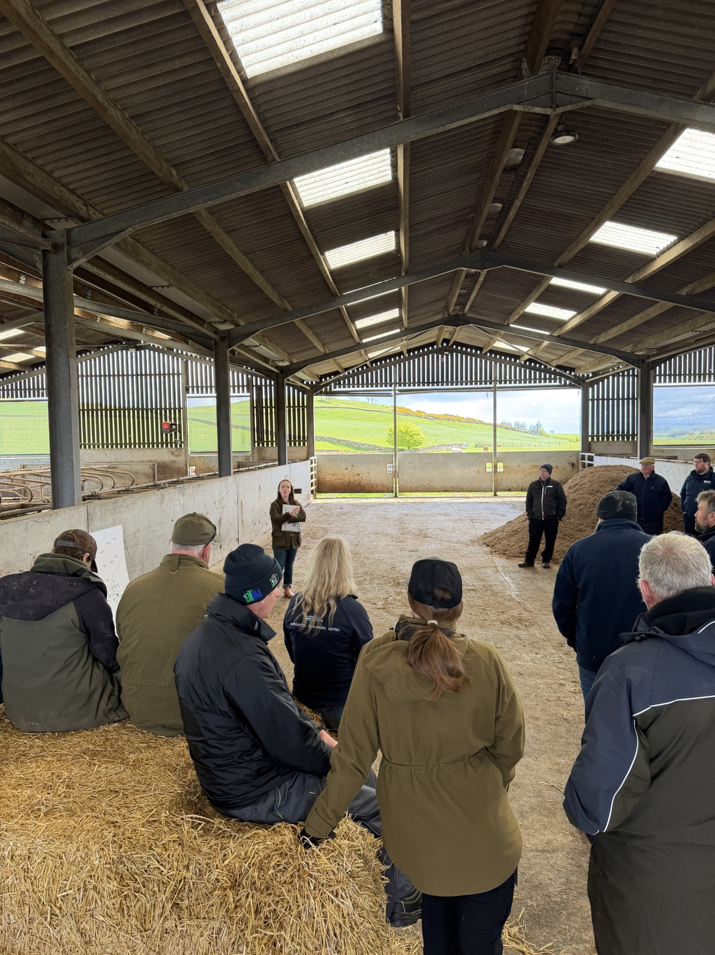
Speaker insights
Emma McGowan - Genetics Specialist at Quality Meat Scotland.
Emma works on improving animal genetics and making sure farmers and others in the industry understand how genetic research can help them. She has a PhD in the field, and her knowledge is helping to make real improvements in livestock breeding.
She works to identify areas for improvement in the form of genetic projects that can aid the sector in accomplishing its goals for efficiency, profitability, and sustainability. Her experience both at a farm level and at a research level helped to keep research focused on delivering agriculture. Emma focuses on the genetic optimization of the red meat sector to accelerate its ability to achieve sustainability goals while prioritizing continuing to deliver one of the most important public goods; a safe, reliable food supply.
Take Home Message - The traits driving productivity also drive environmental sustainability.
DUMFRIES

