Slide 1
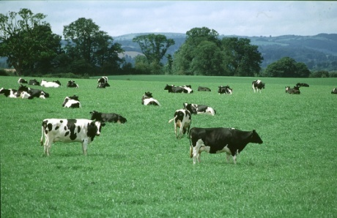
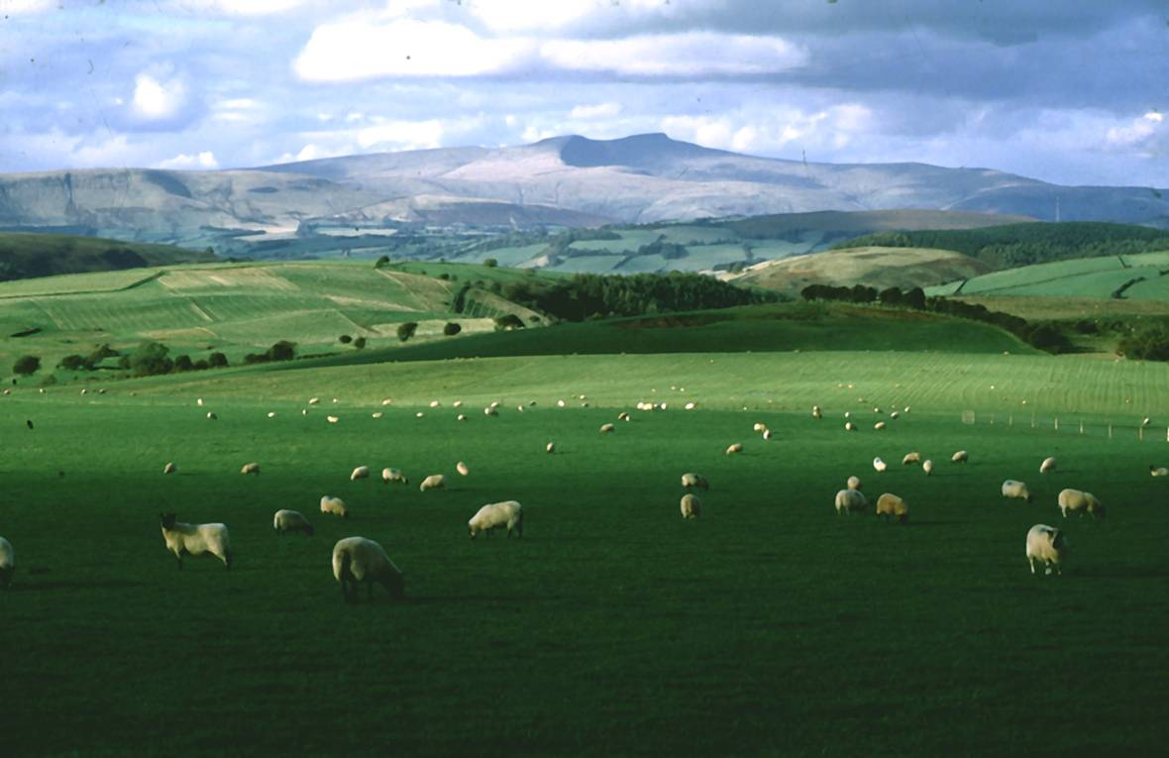
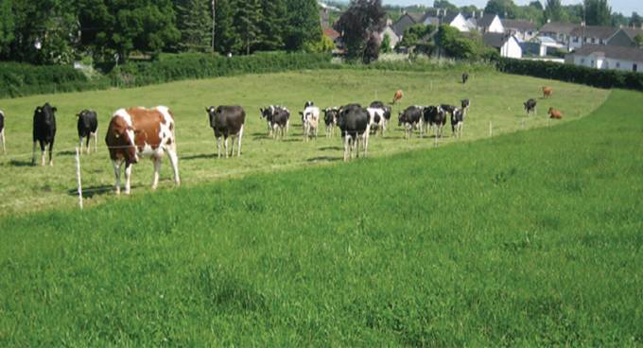
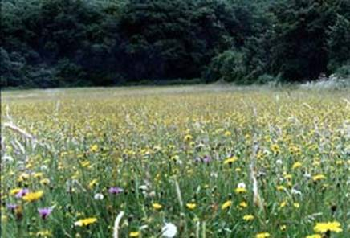
Grass the Low Cost Feed? Can we use it better?
Charlie Morgan GrassMaster Ltd
Integrating Production and Environment

Slide 2

Points to Cover
What is the cost?
What do we control?
How does grass grow?
How do we improve efficiencies?
How do we know we have?
Summary

Slide 3
CAFRE Benchmarking
Notes:
Each extra 10kg of lamb produced from forage per ewe, is worth £15 gross margin per ewe.

Slide 4
Biological
Feed the soil regularly through plants and OM inputs
Move soil only when you have to
Diversify plants in space and time
KNOW YOUR SOILS; principles to improve soil health
Chemical
Physical
Maintain optimum pH
Provide plant nutrients – right amounts in the right place at the right time
Know your textures and minerals – buffering capacity, free supply!
Know your textures and understand limits to workability, trafficability
Optimise water balance through drainage if necessary
Improve soil structure – effective continuous pore space
eg. texture, structure, water repellence

Slide 5
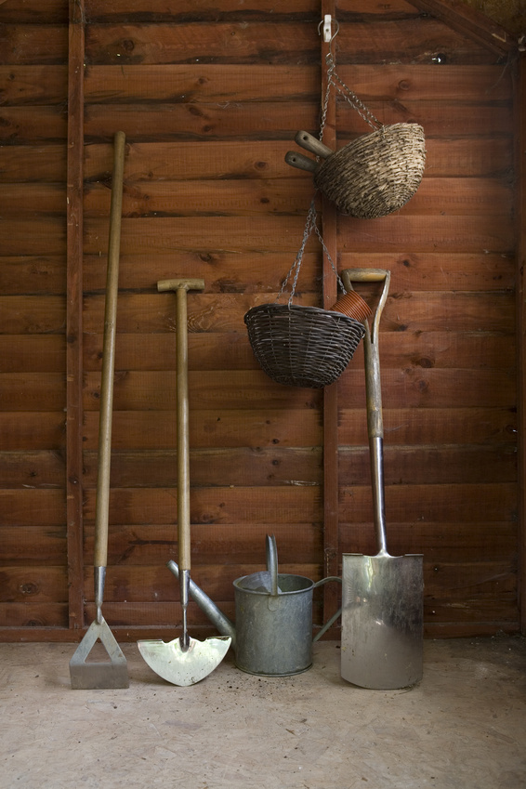
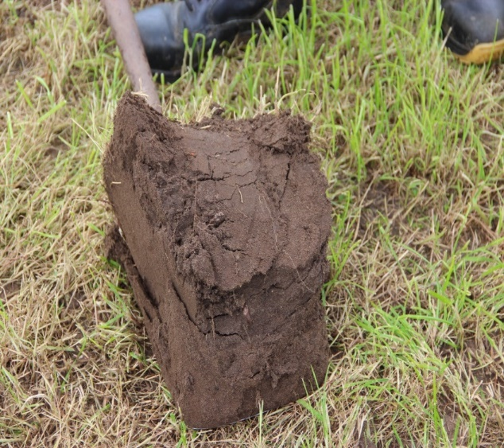
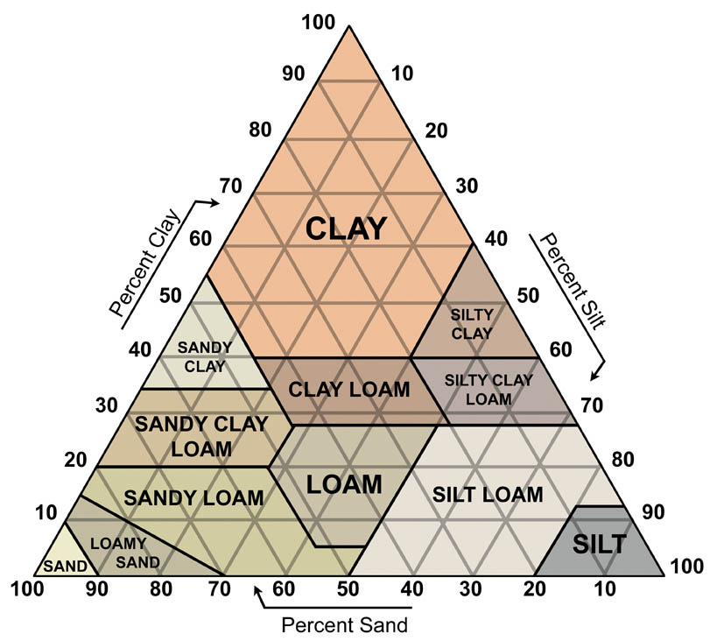
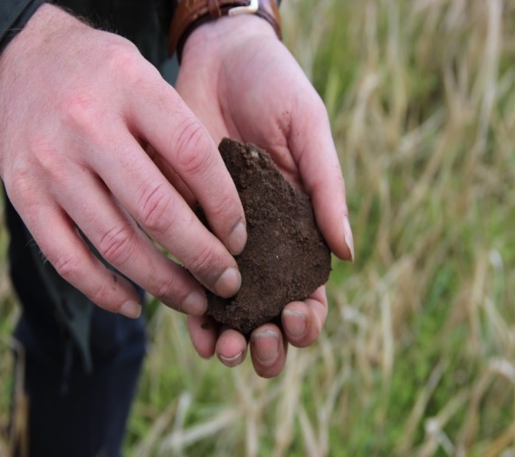
Know your soil

Slide 6
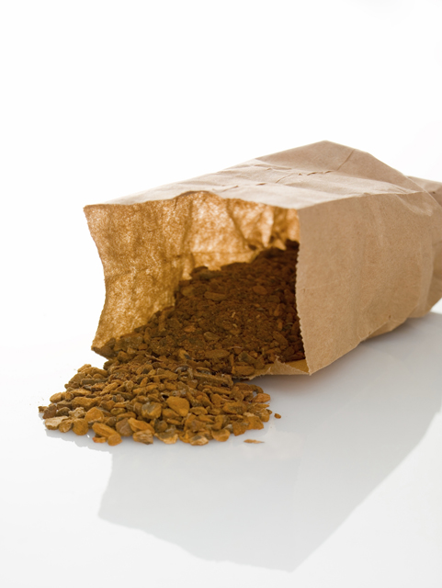
pH
P
K
Mg
OM
+

Slide 7
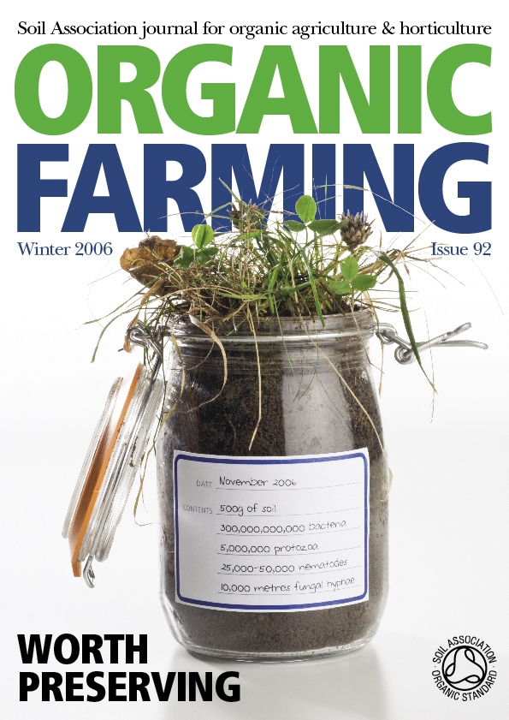
SOIL LIFE
There is lots of it
Very species rich – still more to find and identify
Hangs out in hot spots
High proportion dormancy
Specialists – but lots of shared roles

Slide 8
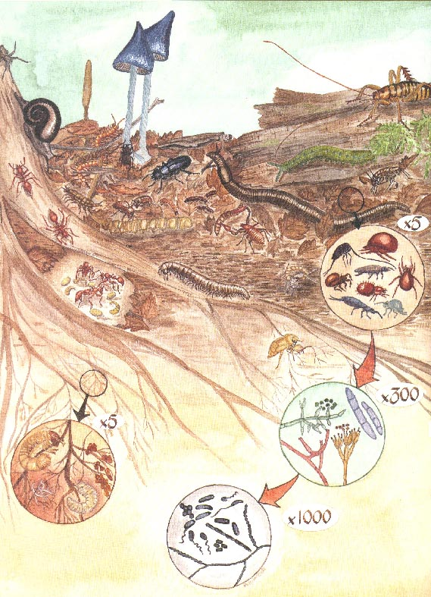
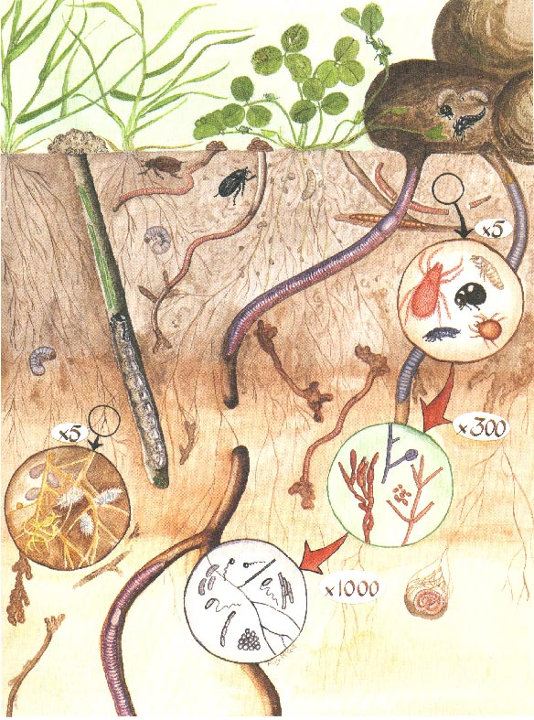
Source: Molloy, L. (1988) Soils in the New Zealand Landscape.
Notes:
Once soils are converted to agriculture, there are major changes in the relative abundance of soil organisms. The processes that occur are the same as in natural ecosystems, but there are major changes in the distribution of organisms and in the numbers of different groups of organisms.

Slide 9
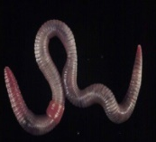

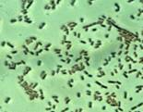


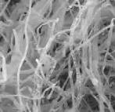

Decomposition – transforming the sun’s energy
a joint venture for the food web
Earthworms
Protozoa
Plant residues
Soil organic matter
Bacteria
Bacterial feeding
nematodes
Predatory
nematodes
Collembola
Enchytraeids
comminution
Fungal feeding
nematodes
Fungi
Fungal feeding
mites
Predatory
mites

Slide 10
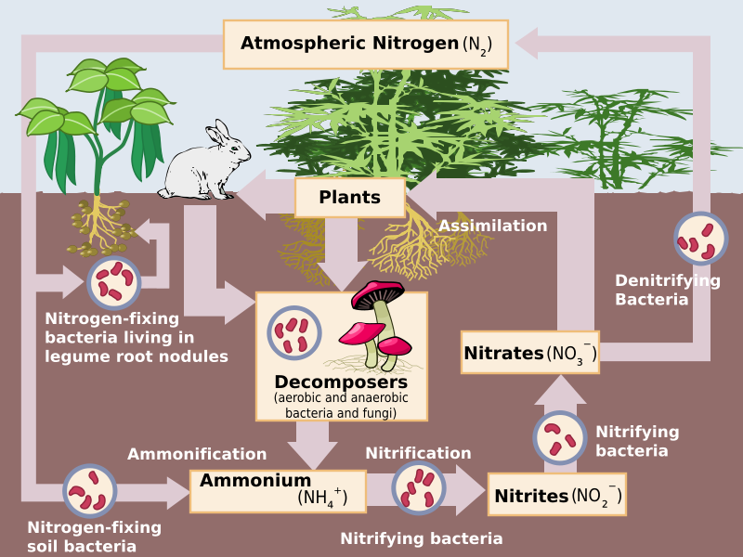

Slide 11
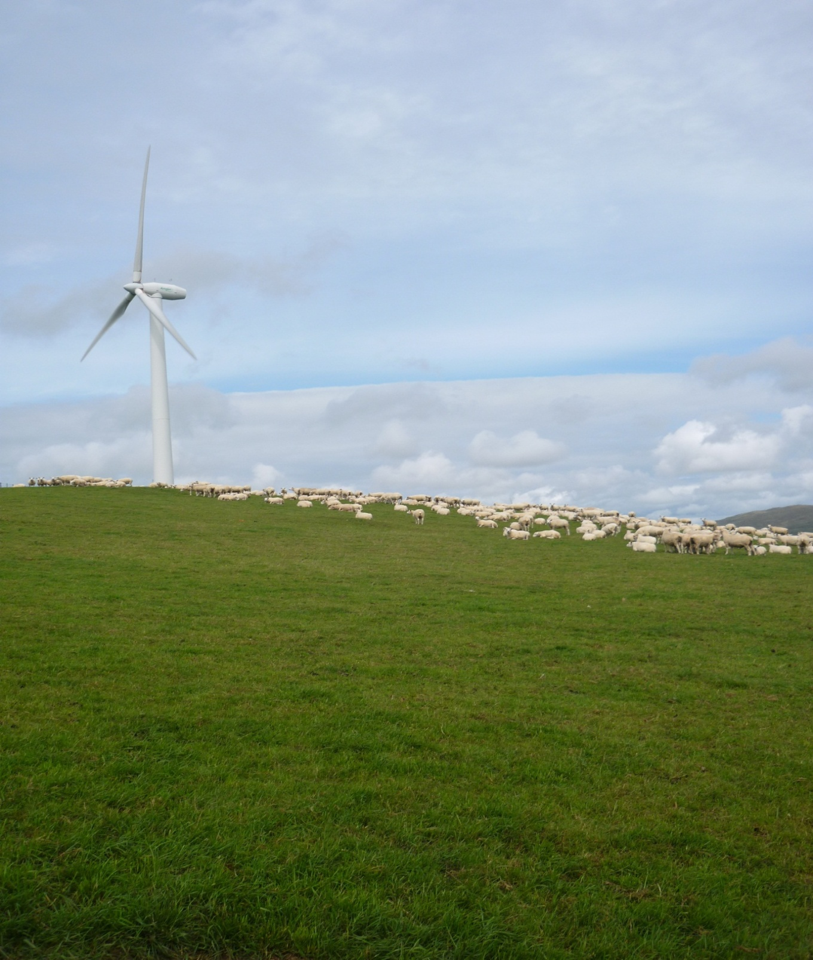
Farm Nitrogen

Slide 12
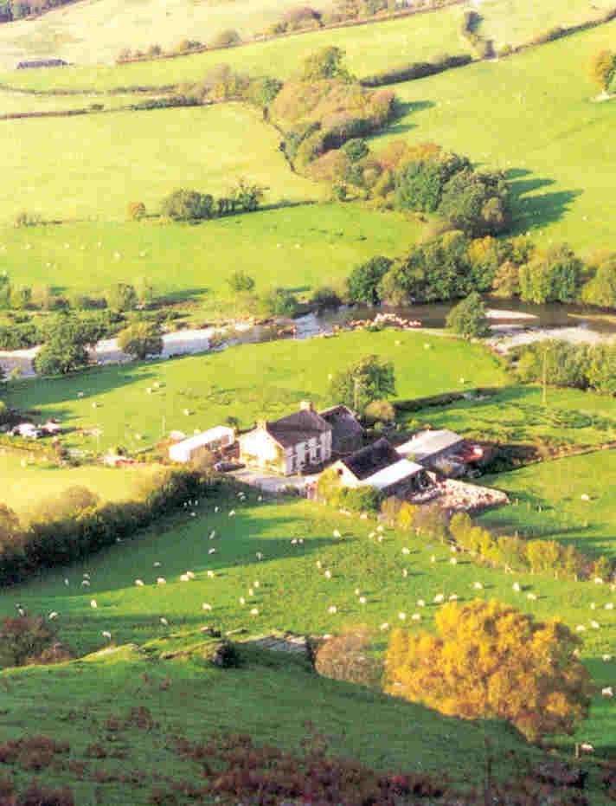
Fertilisers
Muck &
Slurry
Atmosphere
Soils - mineralisation
Clover
Nutrients on farm
Purchased feed plus straw
Sales
(meat, wool and milk)
Leaching
and run off
Losses to
atmosphere

Slide 13

Forage crops in livestock systems
Plant
Conservation
& silage losses
Building fertility
Nutrient inputs
Home-grown
forages
Feed supply
(reduce
feed costs)
Animal
Soil
Reducing leaching
Improve animal health
Best use of slurry
Notes:
13
Research – aims to study components within the farm system.
Recently completed 5 year Defra-funded project - Aim – understand where in the plant-animal-soil cycle – greatest potential to use home-grown forages to
Build soil fertility
improve nutrient efficiency in livestock SO AS to improve productivity BUT Also reduce nutrient losses by
– maximising nutrient capture and retention
- optimising nutrient requirements of forages
Result = win-win situation for production and the environment.
But also look at – effects on animal health

Slide 14
Four points to consider when aiming
to produce quality beef, lamb or milk
Soil Management
Water and Landscape (Environment)
Pasture and Grazing Management
Animal Husbandry and Genetics,
Health and Welfare

Slide 15

Low input/extensive systems
An experiment was set up in 1990 to study the effect of reducing inputs into previously fertilised upland pasture.
Six treatments were imposed (replicated three times) on 25 year old perennial ryegrass and creeping bent dominant swards.
1) Lime (2t/acre at Yr 1), P and K and 150 kg N/ha
2) Lime and P and K
3) Lime
4) Nil input
5) Nil inputs, no grazing, one hay cut (July)
6) Nil inputs, no cutting

Slide 16
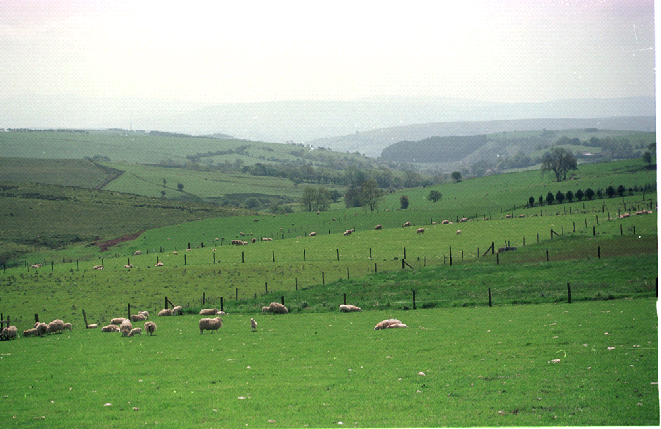

Slide 17
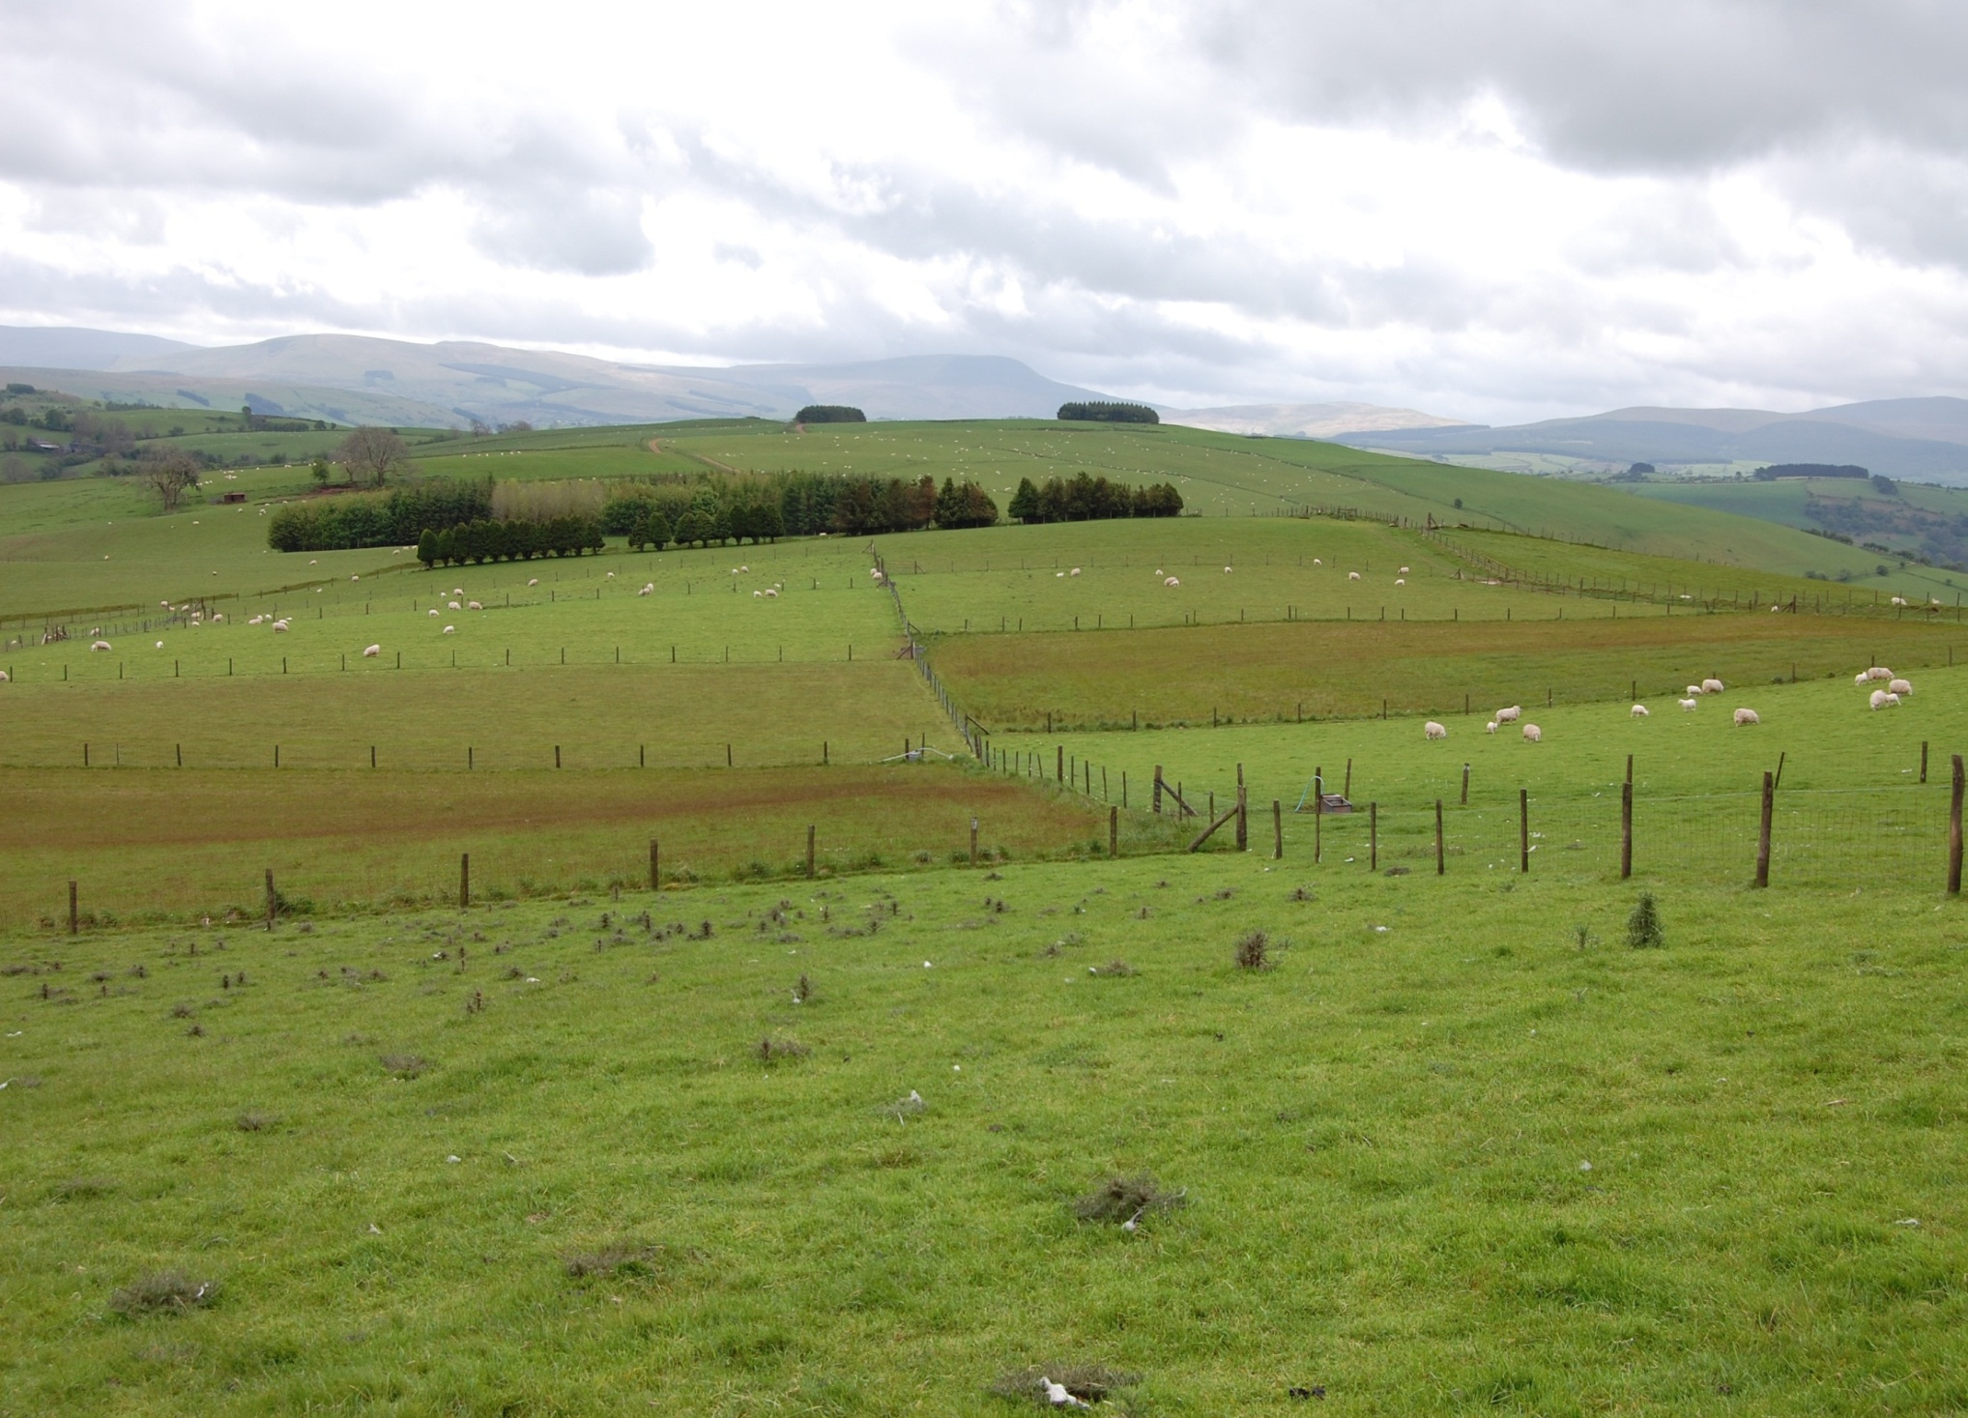
Maintaining sward quality
CaPK
Ca
CaPKN
Cut
Nil
CaPKN
Cut
CaPK
IBERS Bronydd Mawr
Charlie Morgan, IBERS
Ca
Notes:
1990 on 25 year old sward
1) Lime (2t/acre at Yr 1), P and K and 150 kg N/ha
2) Lime and P and K
3) Lime
4) Nil input
5) Nil inputs, no grazing, one hay cut (July)
6) Nil inputs, no cutting

Slide 20
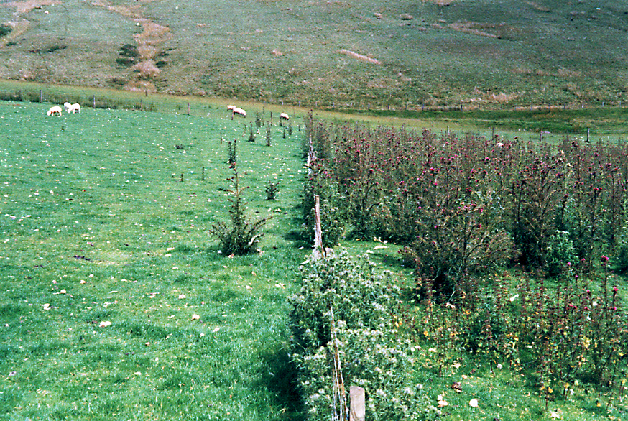
Huge differences between treatments in thistle infestation
Thistle Density (plants/ha) 1999
Surface area of plot reduced by 30% at flowering
CaPKN
Ca
Cirsium palustre Marsh Thistle
Cirsium vulgare Spear Thistle

Slide 21
Changes in ranking of grass species 1990-1998
Treatment | Ryegrass | Meadow grass | Bent grass | Yorkshire Fog | Sweet Vernal | Crested Dogstail | Fescue | Total | Clover Stolon
CaPKN | 12197 | 10553 | 8078 | 6918 | 280 | 1028 | 11 | 39064 | 12.7
CaPK | 8940 | 3777 | 12753 | 6941 | 617 | 1347 | 41 | 31146 | 80.5
Ca | 4334 | 847 | 15693 | 8092 | 502 | 4219 | 49 | 33740 | 45.7
Nil | 477 | 58 | 15657 | 9687 | 395 | 2311 | 82 | 28667 | 19
Nil-Cut | 283 | 28 | 6063 | 3272 | 2904 | 389 | 417 | 13356 | 13.1
Nil-Nil | 0 | 219 | 2876 | 488 | 360 | 0 | 389 | 4332 | 0
How much will this affect output and profitability?

Slide 22
Relative Stock Carrying Capacity
Notes:
22

Slide 23
Indications are that grazing low input swards to the 4cm sward surface height guidelines may cause problems for the long term health and fecundity of the flock
Mean ewe condition score in autumn 1995-98
Target
Notes:
23

Slide 24

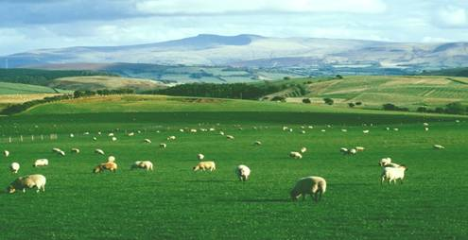
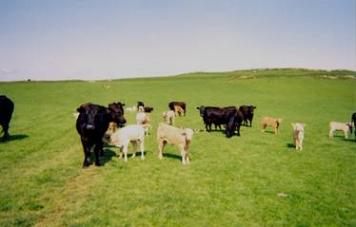
Cost of production and Comparisons
2005
Cost of nitrogen (34.5%) was £160/t
Cost of grazed grass using 200kg/ha of N
was around 4.3p/kgDM with high quality swards
2018
Cost of nitrogen (34.5%) is £250/t
Cost of grazed grass using 200kg/ha of N
is now around 6p/kgDM
Compare with a concentrate
at 22-24p/kgDM
Notes:
24
Rental Value = £250
Reseeding costs = £350/6 = £58
200kg N (@113p/kg) = £226
Fertiliser application = 4x10=£40
Maintenance PK, pH = £53
Total = £627/ha
£627/10,000kg = 6.3p/kgDM

Slide 25
Six Year Ley | Total cost per Ha | Cost per Year / Ha
Reseed costs | 500 | 83.00
Rent @ £150/acre | 2220.00 | 370.00
Lime 5t/ha | 125 | 20.83
Nitrogen @72p/kg plus clover | 439.00 | 73.00
Phosphate maintenance @65p/kg | 78.00 | 13.00
Application costs | 180.00 | 30.00
Total | 3538.98 | 589.83
Based on a grazing system

Slide 26
The cost per Kilogramme of Dry Matter now
depends entirely on yield
£589 ha / 10,000 kgDM/ Ha = 5.89p
£589 ha / 8000 kgDM/ Ha = 7.37p
£589 ha / 5000 kgDM/ Ha = 11.78p
The most significant cost is Rental value
And what’s happening to the quality of the sward?

Slide 27
Impact of lower yield
£21/ewe
£133/Steer
p/kg DM
£10.5/ewe
£67/steer
Ewe over grazing season 210 days = 420 kg DM
Notes:
7.65 276.7442
6.8 553.4884
5.95 830.2326
5.1 1106.977
4.25 1383.721

Slide 28
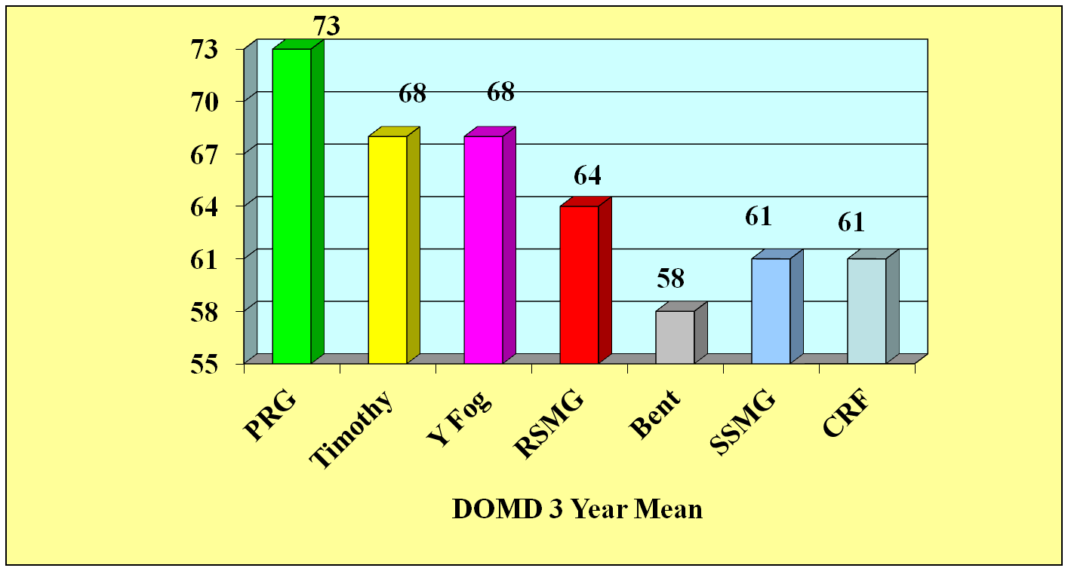
Quality
Source J Frame 1991
Notes:
J Frame (1991) showed significant differences in the DMOD (D-Value) of grass species. At that time perennial ryegrass out performed all other species by at least 5 points. Work at NIAB has indicated that a 1 point improvement in D-Value can lead to an increase in animal performance of 5%.
Extrapolating from this would indicate that animals fed ryegrass would out perform stock fed the next highest other species by 25% and those fed the worst species Creeping Bent by a massive 75%.
These figures do not take account of the increase DM yield of ryegrass nor its palatability and therefore increased voluntary intake.
Since 1991 grass breeders have significantly improved the D-Value of perennial ryegrass by several points, thus increasing this already big divide.

Slide 29
Digestibility (Quality)
Proportion of each mouthful that can be digested
1 point of D-value
20g/day LWG in lambs
40g/day LWG in cattle
0.3ltrs milk/cow/day
Massive driver for animal performance

Slide 30
Response to N
Yield response to increase in N from 50 to 150 units
Source WPBS
Notes:
In highly productive grassland the ability of the sward to respond to high rates of nitrogen (N), both organic and inorganic, is vital. The ability of ryegrass to take up and use N is one of the main reasons for their success in GB agriculture. There is a linear response to N from ryegrass up to 375 kilos/Ha (150 kilos/acre) and good responses up to 500 kilos/Ha (200 kilos/acre).
Ryegrass is able to produce over twice the growth response to N as weed grasses, allowing farmers to either make the best economic use of purchased N or to maximise the free N provided by legumes in the sward.
It is essential that potash (P) and potassium (K) indices are correct to allow any species to maximise their use of N.

Slide 31
Four points to consider when aiming
to produce quality beef, lamb or milk
Soil Management
Water and Landscape (Environment)
Pasture and Grazing Management
Animal Husbandry and Genetics,
Health and Welfare

Slide 32
Management to meet demand
Conservation
Deferred Grazing
Clover or
Herbal mixes?
Brassicas?
Notes:
Value of clover – loses quality later than grass, so can help to fill late summer gap

Slide 33
How grass grows

Slide 34
Don’t graze too early
Or too short
Set stocking

Slide 35
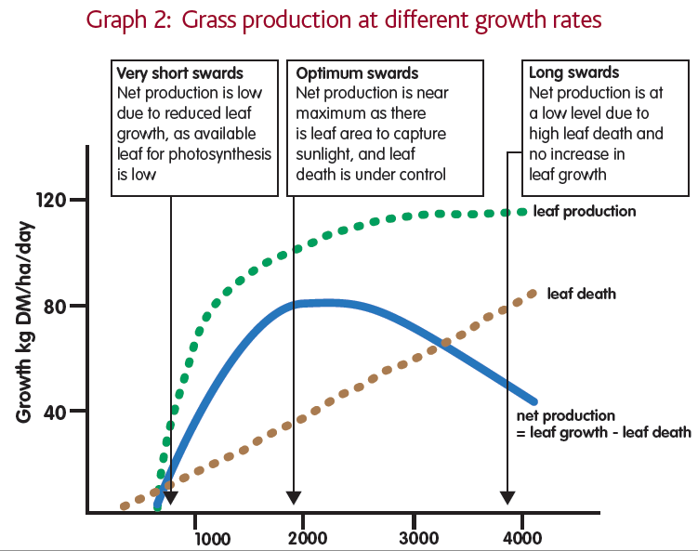

Slide 36
Sward heights
Why sward height targets?
Aiming for increased utilisation
Mouth size
The value is in the leaf
Stem is lower in D-value
Good grazing management can improve every sward

Slide 37
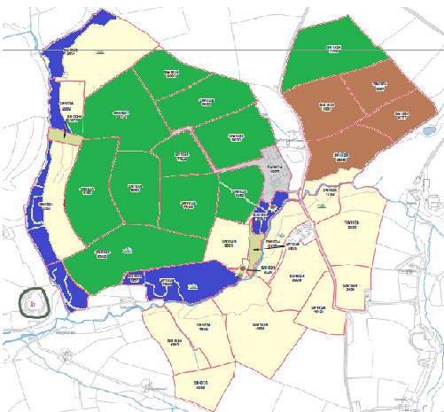
Map Farm Zones
High Production Ground
Medium Production for Grazing
Deferred Grazing
Woodland

Slide 38
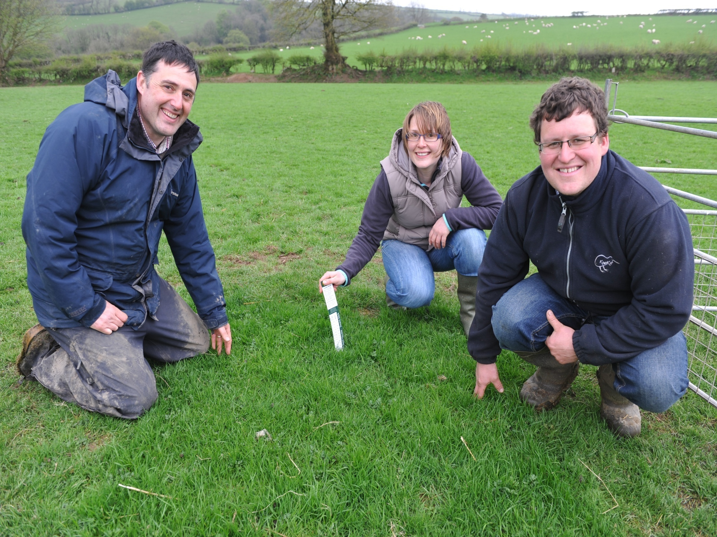
Yield impact of nutrients and new varieties

Slide 39
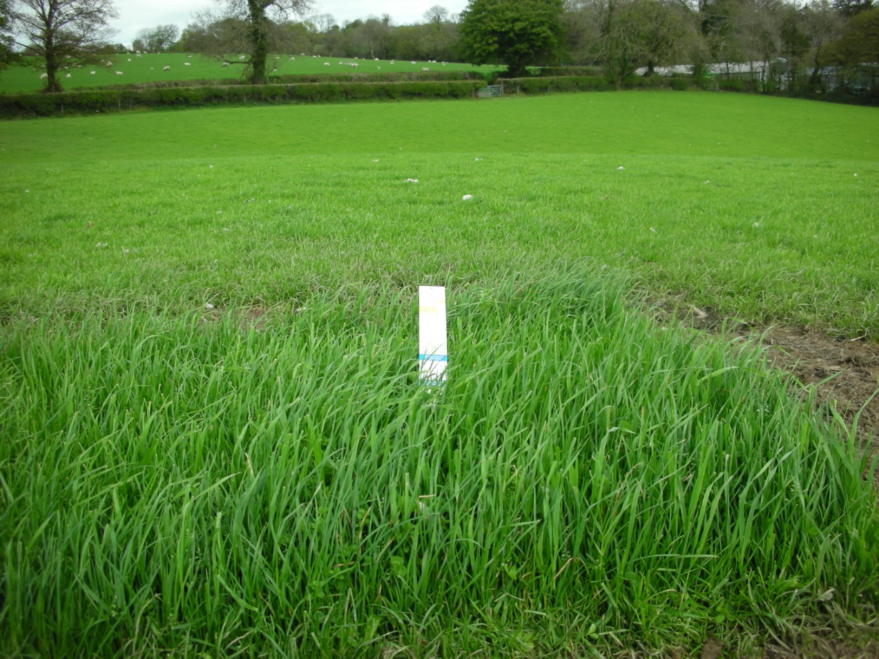
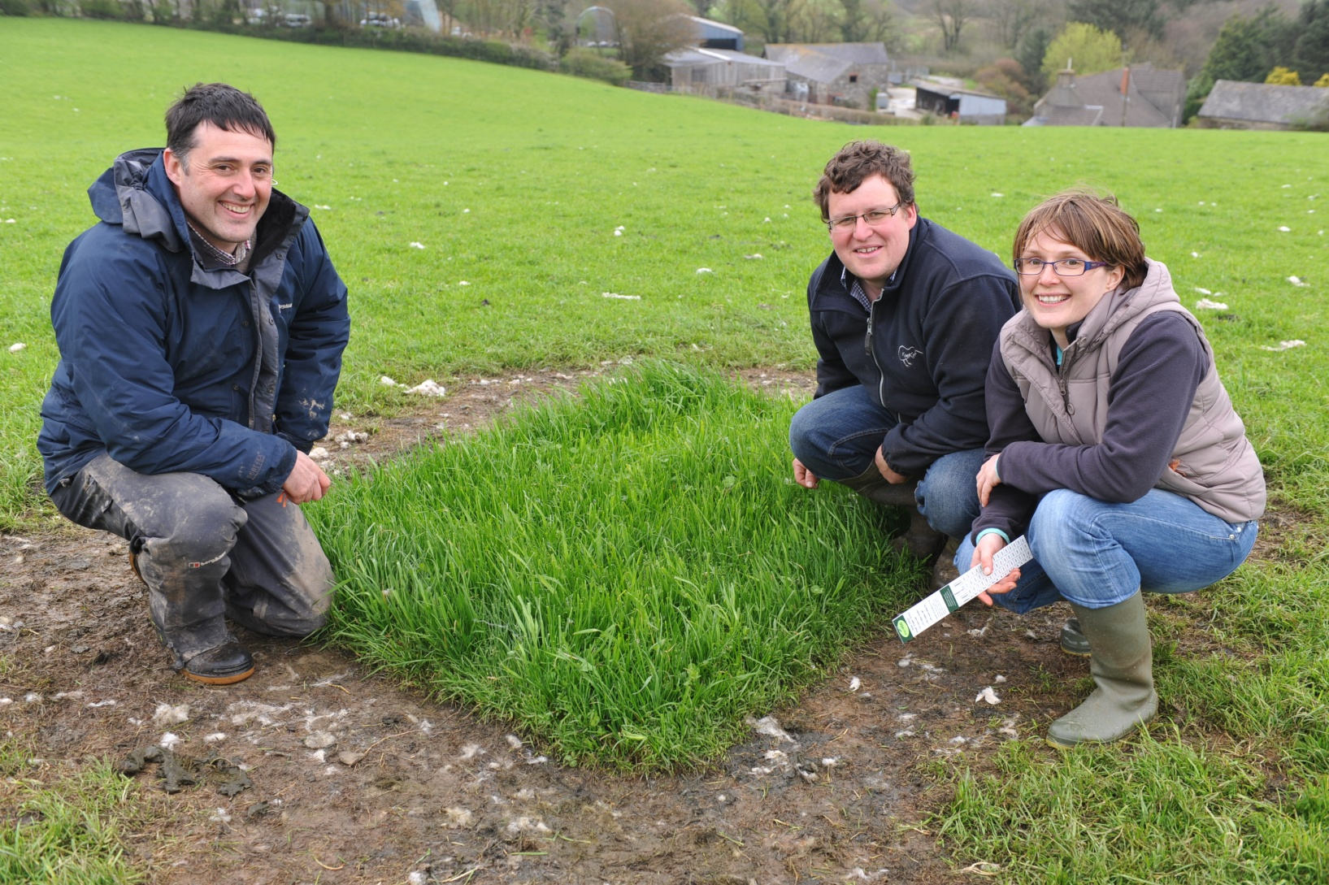
Grown 16cm in 10days
25 yr old field grown 4cm

Slide 40
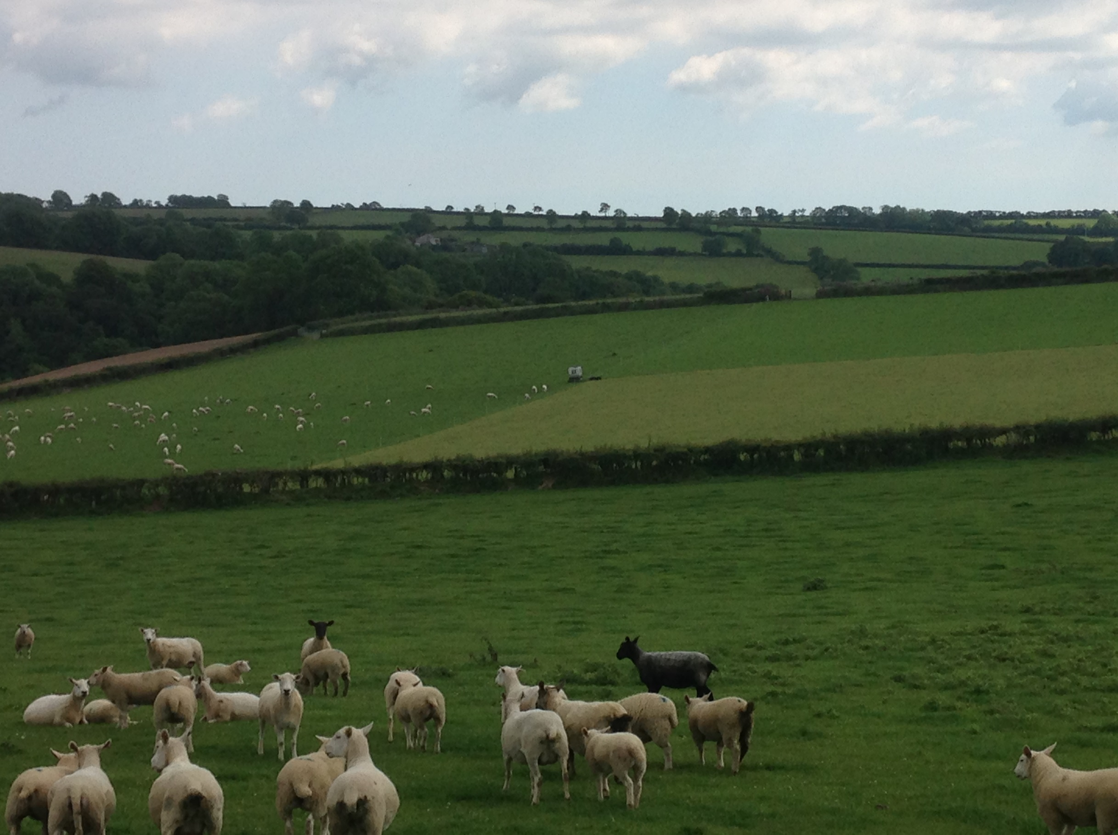
Rotational Grazing

Slide 41
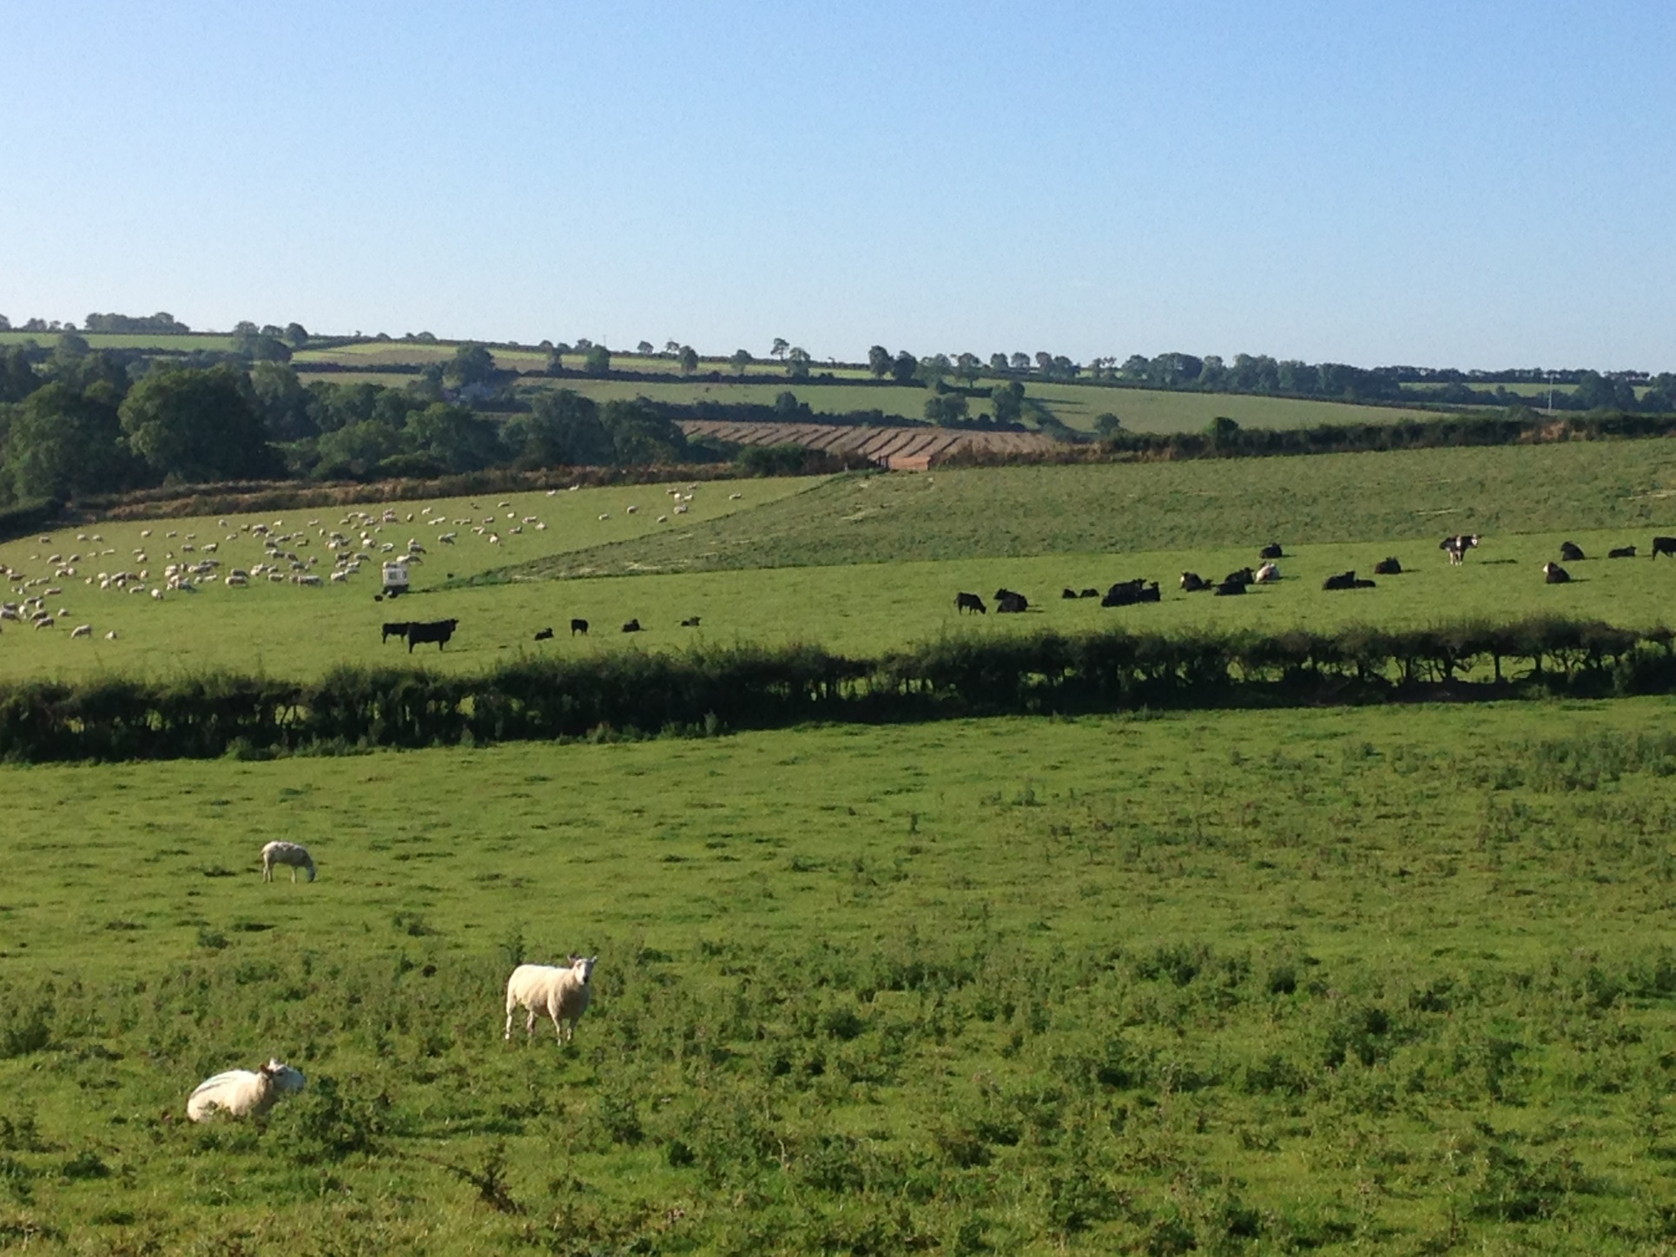

Slide 42
Lamb Output Kg/ha Comparison Figures
 |  |  |  | Output |  |  | Average Weight
 |  |  |  | Numbers sold | Total KG sold | KG/ha | Liveweight | Deadweight
2014 |  |  |  | 745 | 31,253 | 390.66 | 41.95 | 19.80
2015 |  |  |  | 1000 | 40,928 | 629.66 | 40.92 | 19.96
 |  |  |  | +255 lambs | +9,675kg | +239kg | -1.03kg | +0.16kg
 |  |  |  | Lamb sales values |  |  | Production index
 |  |  |  | Total | av per lamb | £/ewe tupped | Kg/ewe LW | Kg /ewe DW | £/ewe |  | £/ha
2014 |  |  |  | 57,892 | 77.71 | 91.89 | 49.60 | 23.09 | 91.89 |  | 723.65
2015 |  |  |  | 65,016 | 65,01 | 103.20 | 64.96 | 30.53 | 103.20 |  | 1000.24
 |  |  |  | +£7,124 | -£12.70 | +£11.31 | +15.36kg | +7.44kg | +11.31 |  | +£276.59
Based on 530 ewes and 100 ewe lambs put to the ram

Slide 43
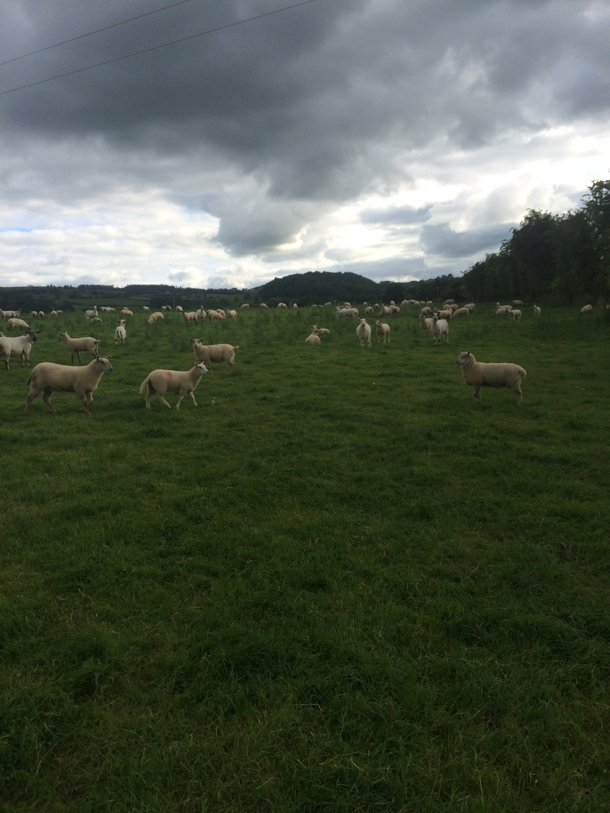
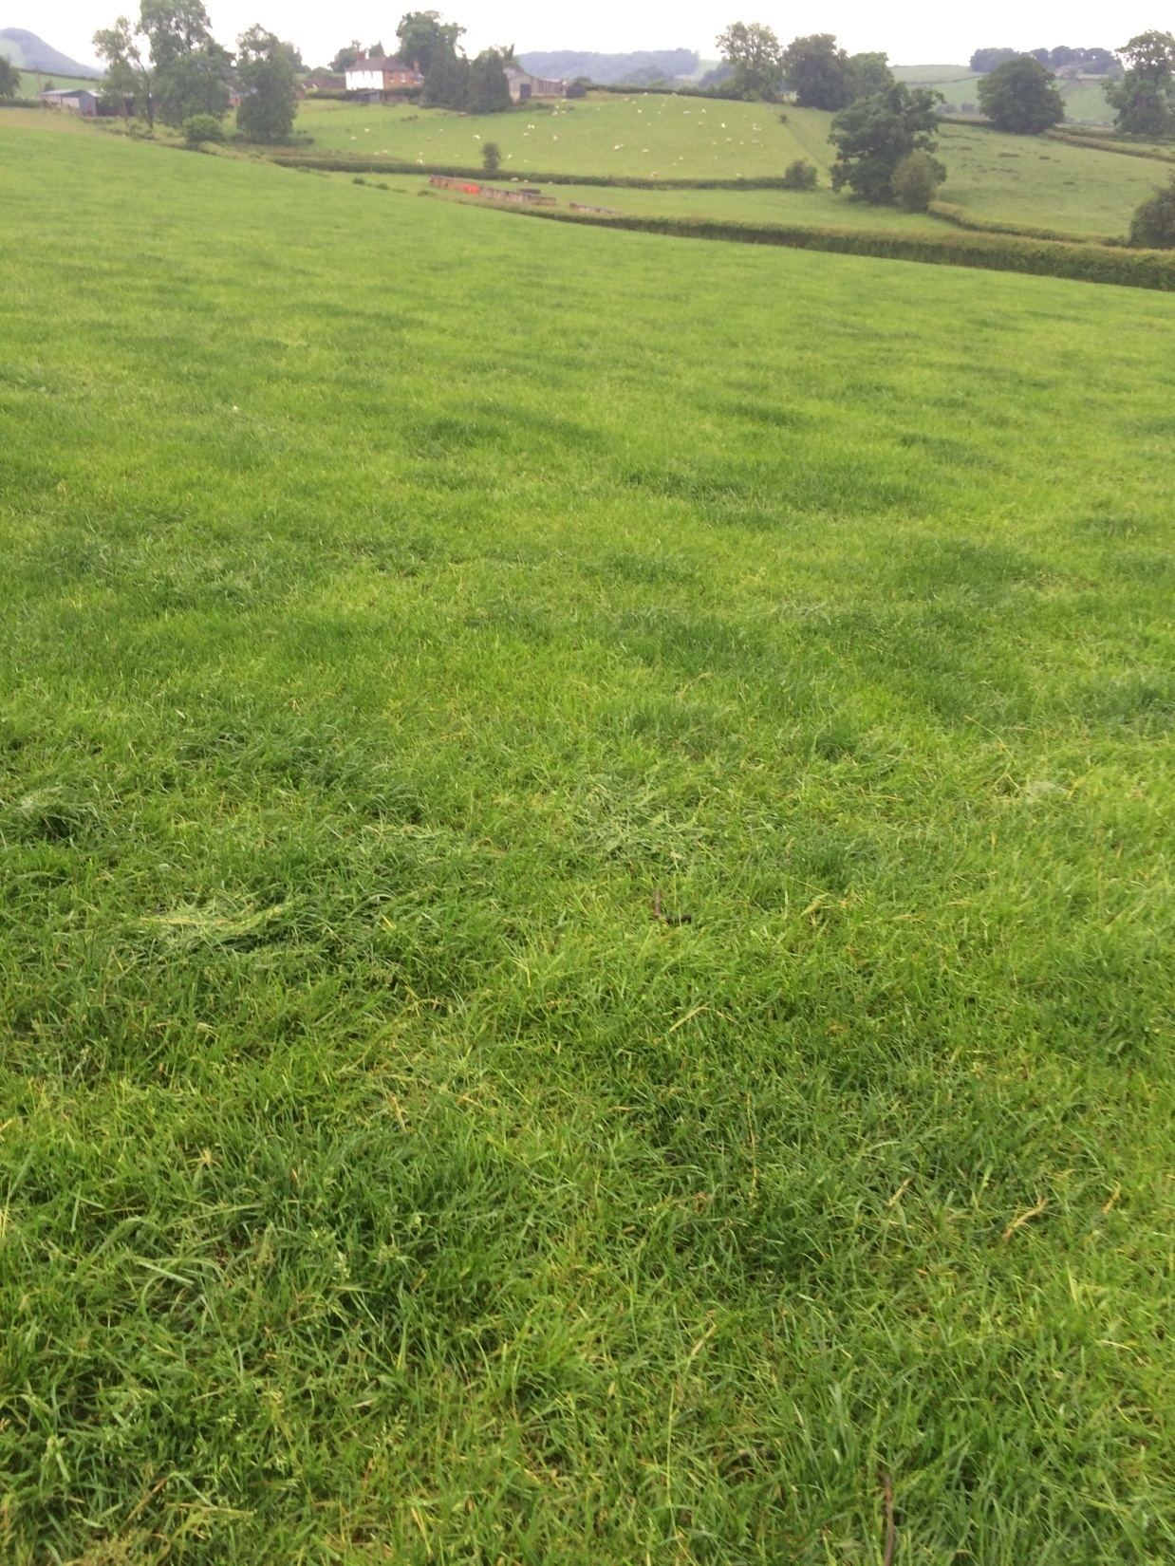
Mark Roberts Powys

Slide 44
Benchmarking Group plan to improve performance
Rotational grazing versus Set Stocked
8 acre paddocks, one split into 4 the other as one area
Stocked with whatever number of ewes and lambs needed
to keep control of the grass (1500kgDM/ha or 4-5cm)
Grass measured weekly and stock moved or adjusted.
Performance recorded as and when convenient.

Slide 46
Rotational Grazing

Slide 47
Set Stocked

Slide 48
What does this mean economically?
Grazing days is the number of days
one animal could to grazed on this area
Rotational grazing 3471 days, Set stocked 2743 days
Difference is 728 days or nearly 2 years
Weight of lambs was 32.5kg and 32.3kg
Number of lambs was 165 and 108 by the 19th June
Total kgs carried was therefore 5362.5kg and 3488.4kg
Lamb price at Welshpool on the day was £1.87kgLW
Value on demo area was £10,027.87 v £6523.20
A difference of £3504.57 or £438.07 /acre
Performance like this will save on rented land for sure

Slide 49
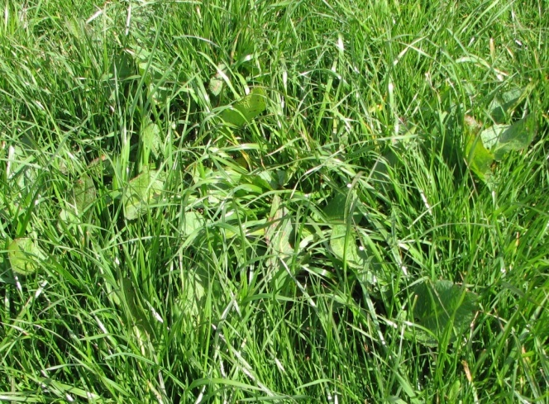
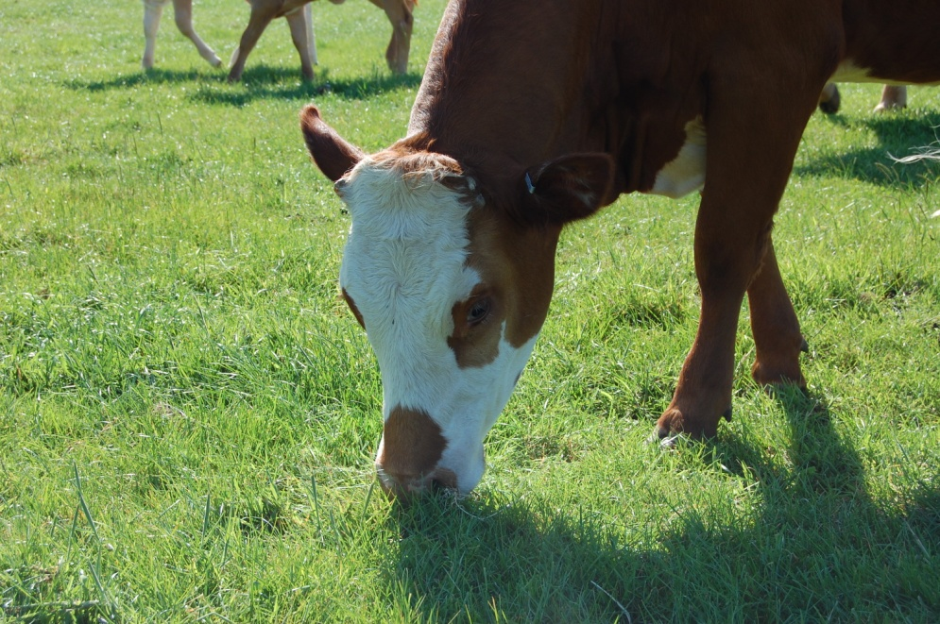
Grass - manage it well to make it pay!
Grazing
grazing heights / covers
monitor and plan grazing
be flexible (integrate grazing
silage and catch crop )
Mow ahead if you need to
Don’t waste cheap feed
and replace with expensive
Notes:
Docks at 5% cover – cost 5% of grass production
5% x 10t = 500kgDM/ha/yr
worth £40/ha/yr in a silage ley (@8p/kgDM)
Sward heights grass budgeting
Under grazing- lower quality material
decreased intake
open swards
take it out for silage if necesessary
Manage rejection areas- topping
Silage making; All year round grazing; Extended grazing; Strip grazing management; Grazing versus conservation;
Integrating with root and forage crops
Attention to detail; Save in concentrate use by making better quality silage 68D v 60D
Cut when sugar content is highest; Avoid high nitrate levels; Avoid soil contamination; Avoid poor consolidation
Avoid poor clamp sealing;
49

Slide 50
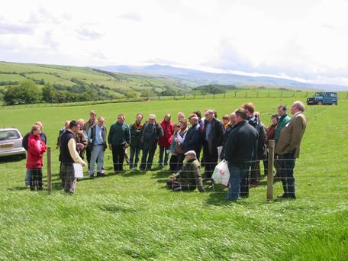
Summary
Stock Genetics and breed are the farmers focus
BUT they are irrelevant if there is
poor management of:
Soils
Nutrients
Grazing and Cutting management
Utilization is key but without sound
soil management it can’t be achieved

Slide 51



Summary
Ryegrass and legumes are our cheapest resource
We need to Grow, Manage and Utilize them efficiently.
Key Performance Indicators prove Rotation works
Don’t waste cheaper feed and replace it with expensive
What are you going to do ?
?

Slide 52
Summary
Ryegrass and legumes are our cheapest resource
We need to Grow, Manage and Utilize them efficiently.
Key Performance Indicators prove Rotation works
Don’t waste cheaper feed and replace it with expensive
What are you going to do ?
?

